Slide 1
Use Scenarios and Patterns
Microsoft Research
Microsoft Azure for Research Training
Notes:
The start of day 2 looks the same as the end of day 1. The trainer should tease out of the agenda slides following, what the key learning points are, and contextualize these items for the attendees. There is also an explicit call for questions and dialogue before continuing.

Slide 2
Use Scenarios and Patterns
Common use scenarios from researchers?
Basic Scenarios
Composite Patterns
Building a Scalable Cloud Service
Notes:
Slide Objectives:
Introduce the topics that will be covered in this session
VALUE PROP
Speaking Points:
Notes:

Slide 3
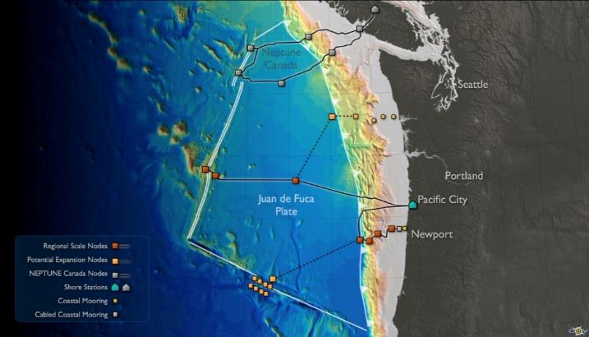
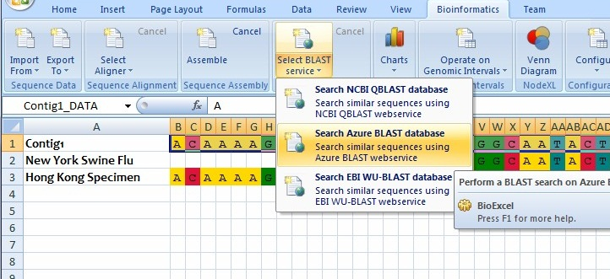
Simple Tools To Answer Complex Questions…
Imagine: the client plus the invisible backend for problem solving
Seamlessly extend standard science and engineering desktop tools
Use a spreadsheet to invoke genomic analysis tools running on 600 servers
Use a simple script to run data analytics and mining across 10000 MRI Images
Pull data from remote instruments for visualization on the desktop
Create a revolution in scientific capability for everybody

Slide 4

Cloud computing makes a difference
Scale beyond your PC/laptop
On-demand, no waiting
Perform big data computations without fuss
Share data with your team, and globally
Build research services easily that can be accessed widely
Pay for what you need

Slide 5
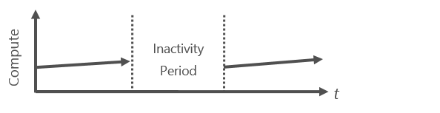
Patterns: On and Off
On & off workloads (e.g. batch job)
Compute only when you need it
No queuing
Over provisioned capacity is wasted
Difficult to handle conventionally

Slide 6
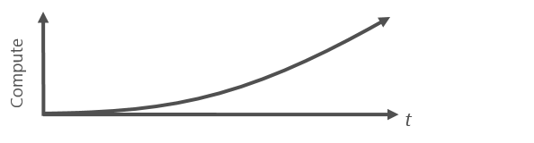
Patterns: Growing Fast
Need to grow/scale quickly
Equally important for data
Keeping up is difficult
Cannot provision hardware fast enough

Slide 7
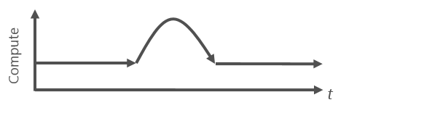
Patterns: Unpredictable Burst
Unexpected/unplanned peak in demand
Unable to satisfy demand (paper deadlines)
Sudden spike impacts performance
Cannot provision for extreme cases

Slide 8
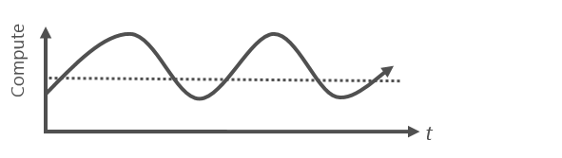
Patterns: Predictable Burst
Predictable trends (e.g. daily, weekly)
Data processing from experiments
Wasted capacity to accommodate

Slide 9
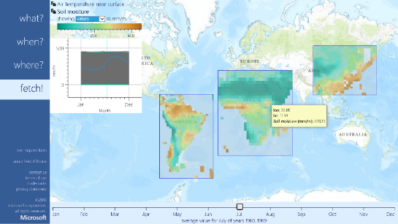

FetchClimate^{Beta}
Intelligent environmental information service
Automatically:
Selects best data source to answer the query
Regrids results
Calculates uncertainty
http://fetchclimate2.cloudapp.net/
Notes:
FetchClimate is an ‘automatic intelligent environmental information service’ – in the sense that you ask it for what you want (e.g. temperature at midday in June) and it selects the best data to answer this query; does all necessary calculations on the fly; then sends back the answer, complete with uncertainty. It can be accessed via code (and so used within other tools), or directly via a compelling browser interface.
See http://research.microsoft.com/en-us/um/cambridge/groups/science/tools/fetchclimate/default.htm

Slide 10
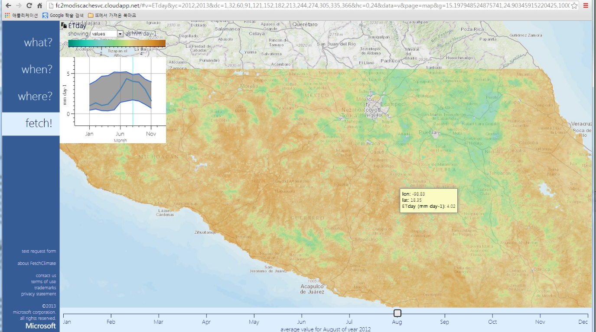
FetchClimate – MODIS Azure results

Slide 11
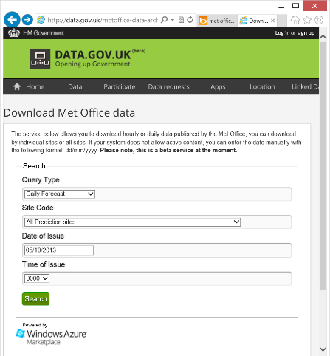
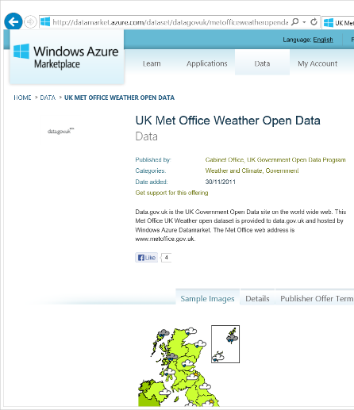
Open UK Weather Forecast Data
Daily forecast + 5 days
3 hourly forecast + 5 days
Observation data
Web search:
“open weather data azure”

Slide 12

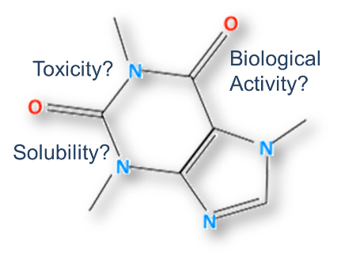





Accelerating Drug Design - QSAR
5 years
10 hours

Slide 13
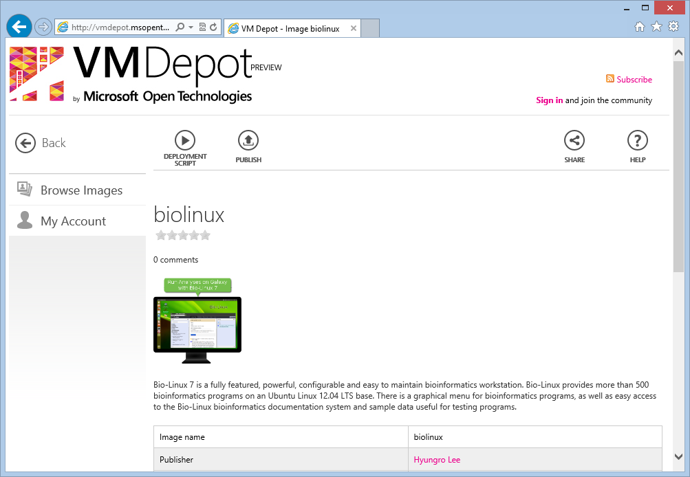
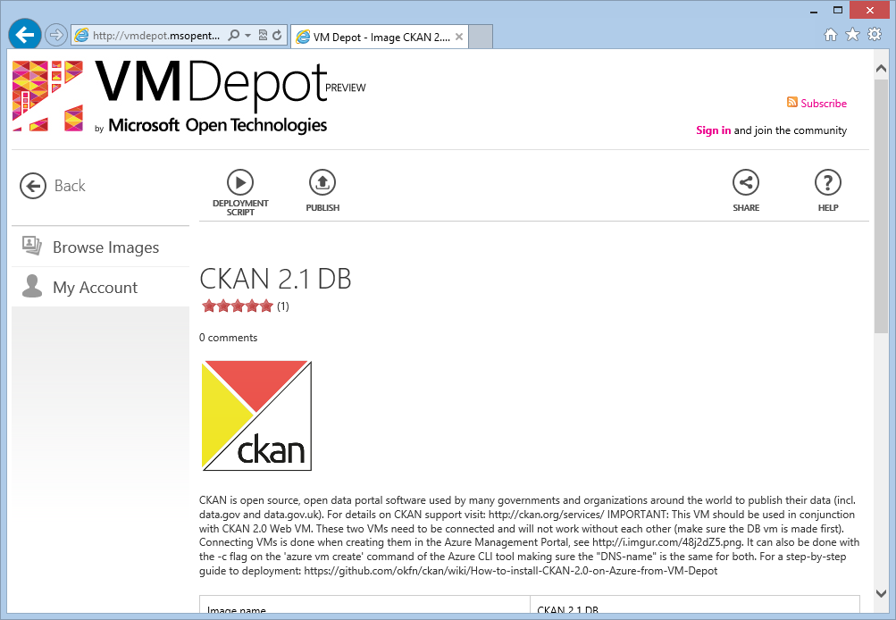
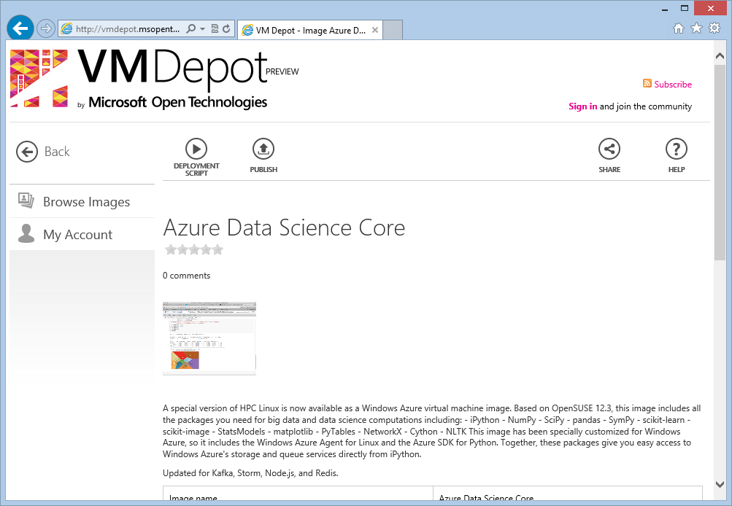
Linux Virtual Machines

Slide 14




Hybrid Cloud for Science
Local Data Centre

Slide 15
Hybrid Cloud for Science
Local Data Centre

Slide 16
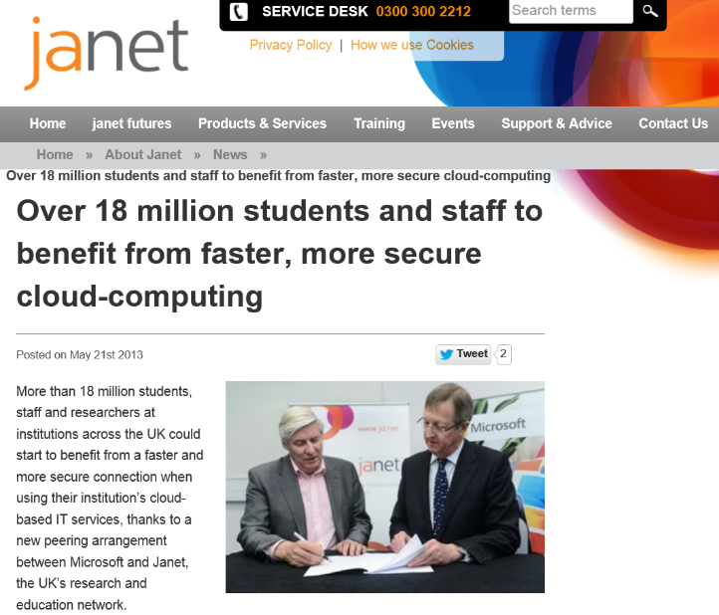

Slide 17
Microsoft Azure Awards
Apply by 15 Apr @
azure4research.com
Microsoft Azure
Environmental Science
Machine Learning
Life Sciences
Computer science
Engineering
Urban Science

Slide 18
Questions?

